Slide 1
A Virtual Arts Exhibition and Poetry Reading
February 1, 2023

Slide 2
presented by Esther Productions Inc. estherproductionsinc.com info@estherproductionsinc.com 202-829-0591
February 1, 2023

Slide 3
featuring
Afrika Abney, abstract paint
Poets:
Beverly Sims; Rosalind Blunt, Sharon Burton, Betty Nyangoni, Ph.D, Kanimozhi MV, Blanche Thomas, Lesa Warrick and jonetta rose barras

Slide 4
The Art of AFRIKA ABNEY an exhibition of original art
February 1, 2023

Slide 5
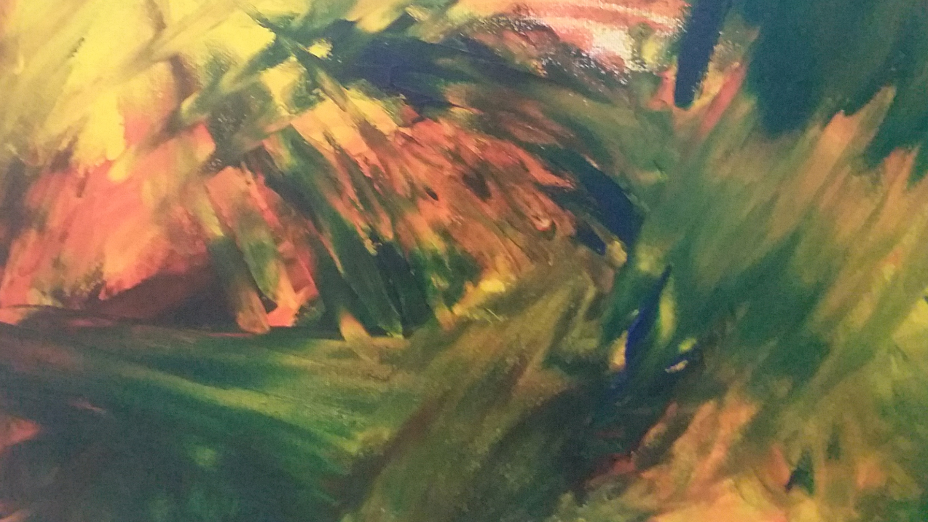
Summer Blossom For Sale: $100

Slide 6
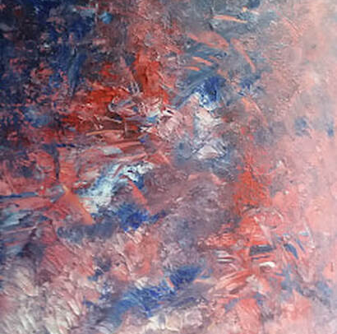
Pandemic
16x20 acrylic on Canvas
$150.00

Slide 7
Isolation 1
16x20 acrylic on canvas--$150.00

Slide 8
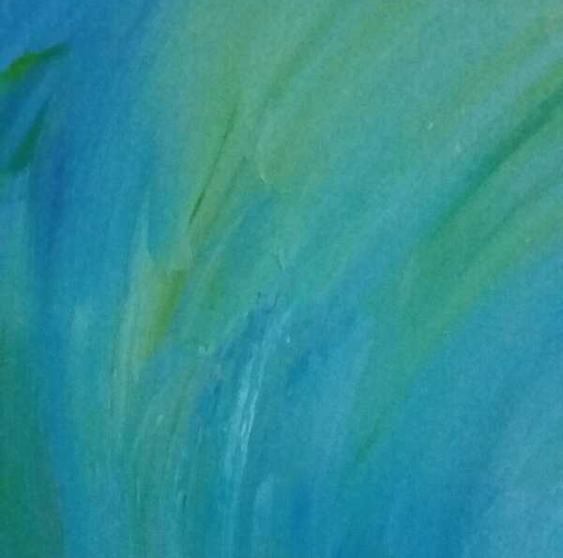
Isolation 2
16x20 acrylic on Canvas
$150.00

Slide 9
The kaleidoscope writers
Beverly Sims
Rosalind Blunt
Sharon Burton
Betty Nyangoni, Ph.D
Kanimozhi MV
Blanche Thomas
Lesa Warrick
jonetta rose barras

Slide 10
Special thanks
Addison Switzer, Buck Wild Media
Kerry S. Pearson LLC
Fort Myer Construction Corporation Charitable Foundation
Emmanuel Bailey, Veterans Services Corporation
Pepco, an Exelon Company
David Jannarone
A.Scott Bolden
Patricia & Ronald Bitondo
Joy Jones
John Allem
Rhonda l. Saunders, Elan Solutions
Afrika Abney
Kaleidoscope: Women of Color Reflecting on Life: On Sale NOW $15.00 estherproductionsinc.com/shop

